Slide 1
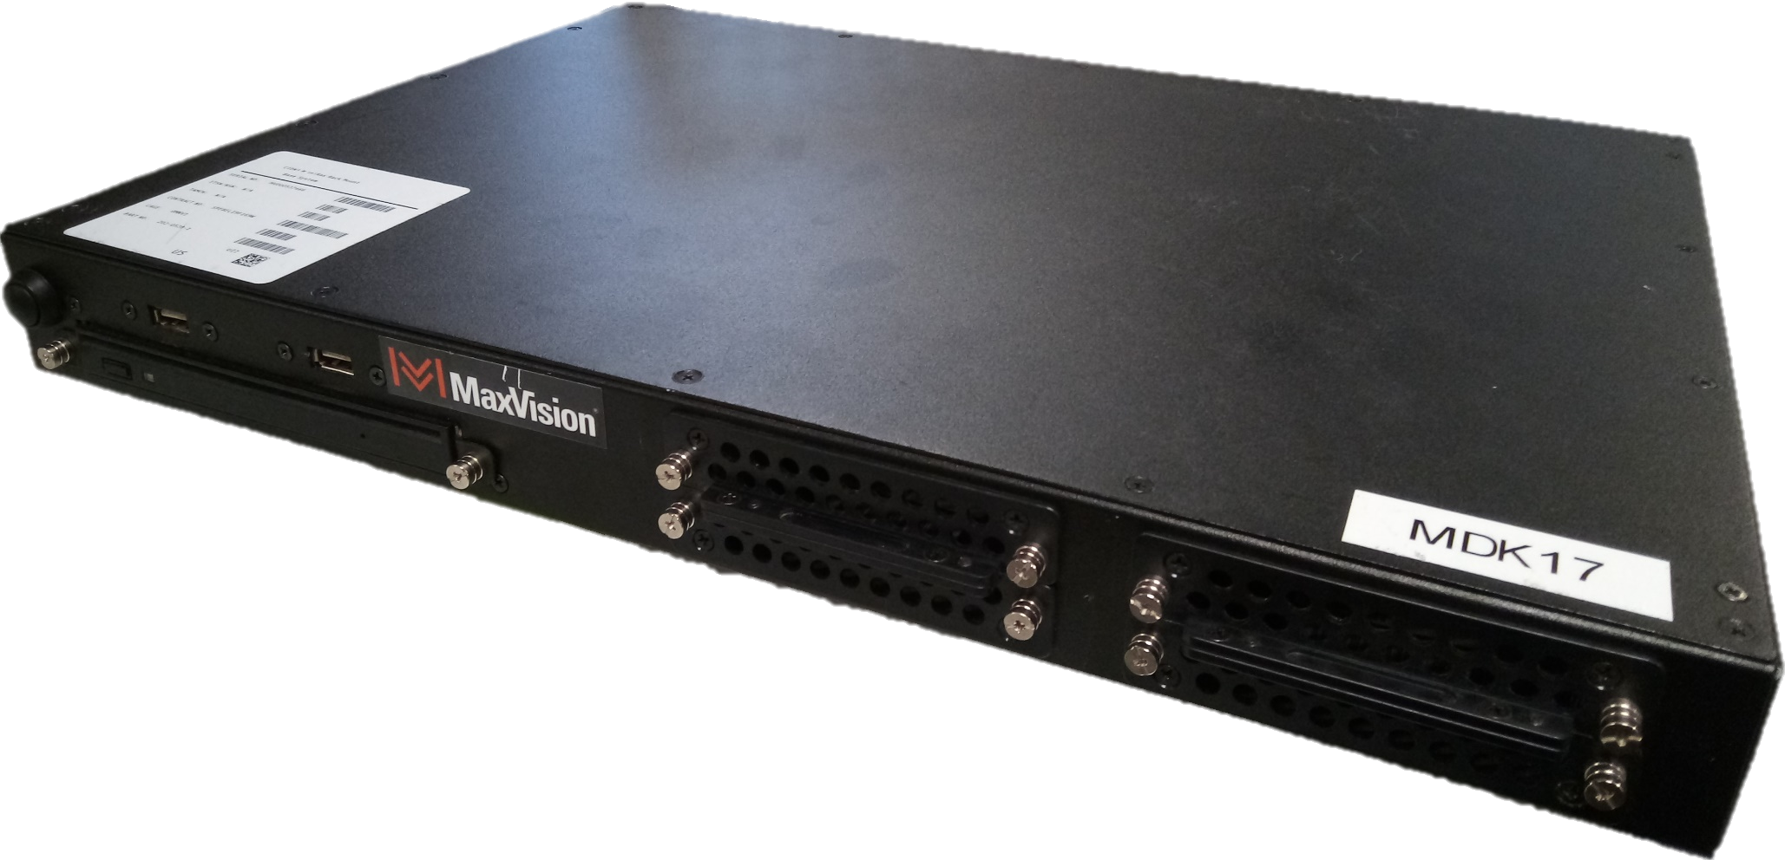
Using the MaxVision MiniRax as a SecurityOnion 2.3 Standalone Sensor

Slide 2
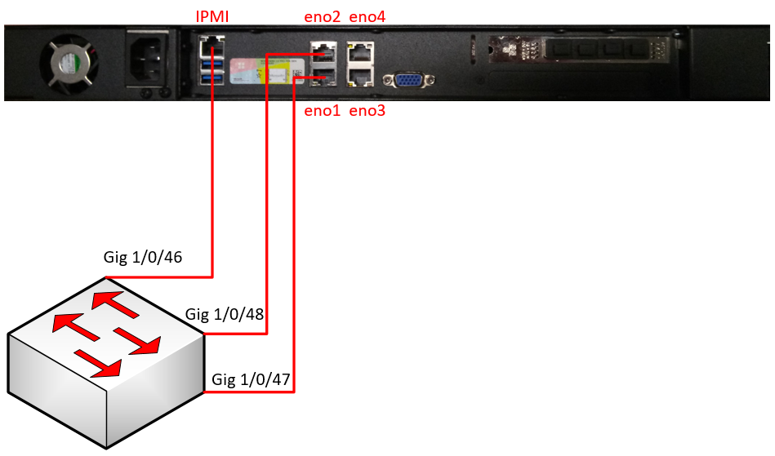
Download the latest version of the SecurityOnion ISO from https://github.com/Security-Onion-Solutions/securityonion/blob/master/VERIFY_ISO.md to the computer where you will be deploying the operating system (OS) from
Connect the Intelligent Platform Management Interface (IPMI) and the interface you will use as the OS management to the switch you will be plugging into. (See figure below)
Connect the sniffing interface to the Switch Port Analyzer (SPAN) port on the switch. If you are using a tap, connect the sniffing interface to the tool port on the tap. If you use a tap the eno2 connection shown below would not apply.
Example: We will be connecting the sensor/server to a switch that has VLAN 10 (users), 20 (voice), and 30 (servers). In this example, we will be placing the management interfaces (IPMI and OS) on the server VLAN. We will assume that the server VLAN is on the 137.233.34.0/27 network. We will always require 2 IP addresses when dealing with any physical sensors; 1 for the IPMI and 1 for the OS.
! Switch Configurations
!
default interface range GigabitEthernet1/0/46-48
!
interface GigabitEthernet1/0/46
description ***DCO SENSOR IPMI***
switchport mode access
switchport access vlan 30
switchport port-security mac-address sticky
switchport port-security
spanningtree port-fast
!
interface GigabitEthernet1/0/47
description ***DCO SENSOR SO MGMT***
switchport mode access
switchport access vlan 30
switchport port-security mac-address sticky
switchport port-security
spanningtree port-fast
!
monitor session 1 source vlan 10 , 20 ,30
monitor session 1 destination interface GigabitEthernet1/0/48
!
end
wr
!

Slide 3
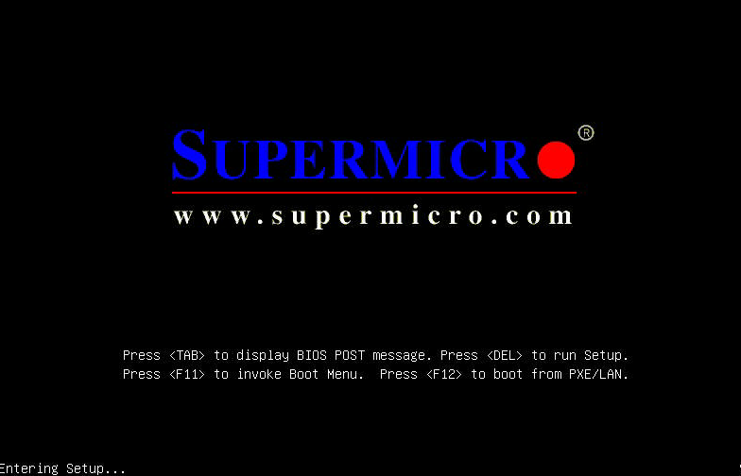
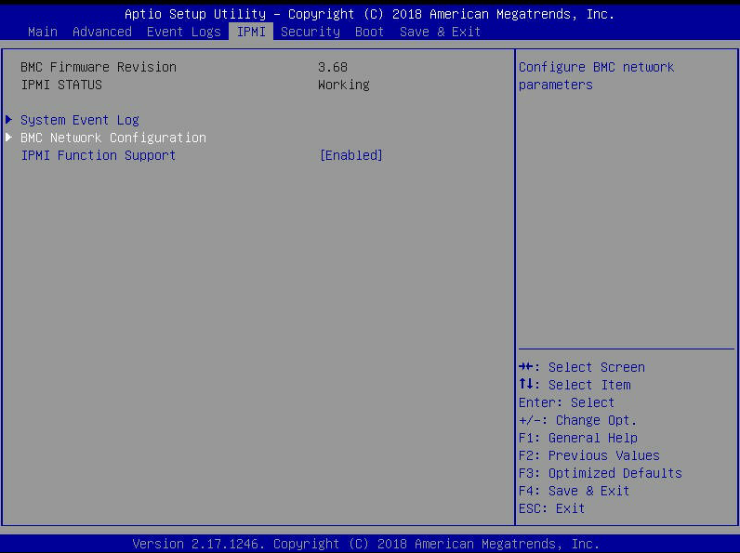
If you have not assigned the IPMI interface an IP address and don’t know the current IP, you will need to assign it through the BIOS using a monitor and keyboard
During bootup, you will need to press the Delete key to get into the BIOS setup menu (you will need to enter the admin password to be able to access BIOS settings)
Once you get into the BIOS, go to IPMI, select “BMC Network Configuation”, and press the Enter key

Slide 4
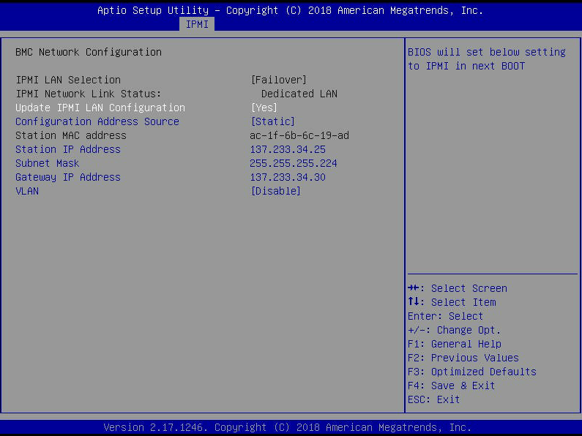
In the IPMI configuration screen, change the “Update IPMI LAN Configuration” value to Yes
Change the IP address values according to the network the sensor/server will be placed in.
In this example, the sensor’s IPMI will have the 137.233.34.25 IP address and its gateway will be 137.233.34.30.
Note: even though the sensor management interfaces will be placed on the server VLAN, we DO NOT need to specify a VLAN ID in the IPMI configuration screen. The only time you would specify a VLAN ID is if the switch port connected to the IPMI interface was configured as a trunk (802.1q).
Press the F4 key to save the configuration changes
When you are prompted to save and exit, select Yes

Slide 5
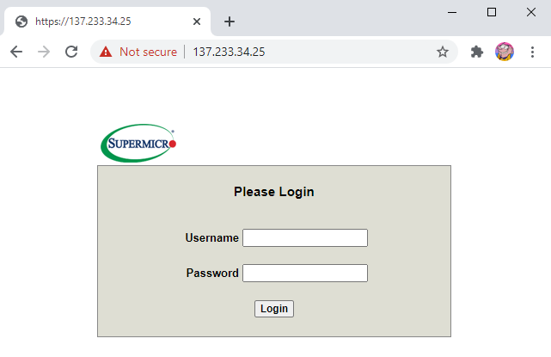
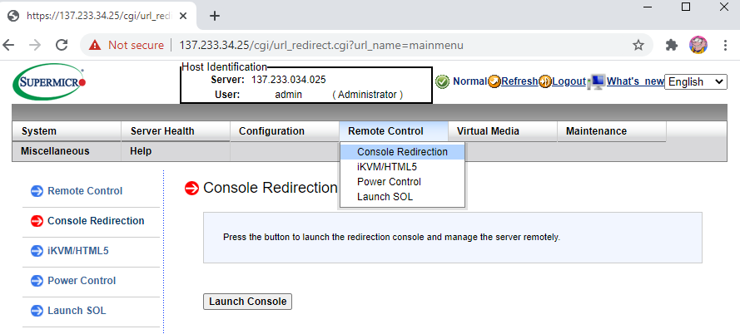
Once you have saved the IPMI configurations, navigate to the web user interface of the sensor/server’s IPMI
Note: the username SHOULD be admin. If it is not, it will be ADMIN in all capital letters. If the standard password does not work for either admin or ADMIN, the password might be the SuperMicro defaults (username ADMIN and password ADMIN)
Once you log in, access the server Java console by going to “Remote Control” and “Console Redirection”
Click the “Launch Console” button (this will download a Java file that will need to be launched). If you don’t have Java installed, install it.

Slide 6
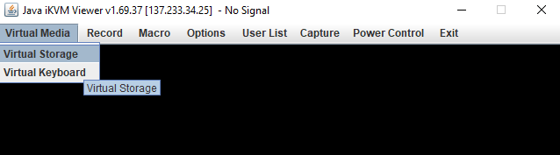
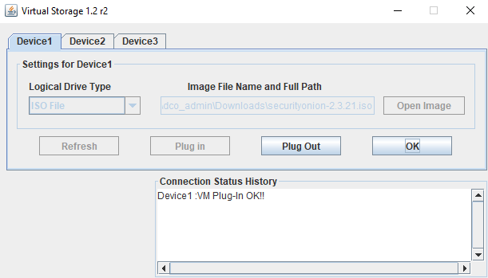
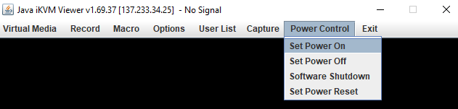
From the IPMI console window, click “Virtual Media” and select “Virtual Storage”
Once you log in, access the server Java console by going to “Remote Control” and “Console Redirection”
Select “ISO File” from the Logical Drive Type drop-down menu.
Click the “Open Image” button and select your ISO file
Once you have your ISO selected, click the “Plug In” and “OK” buttons
If the sensor/server is already running, reset the power on it by going to “Power Control” and selecting “Set Power Reset.” If it’s off, turn it on.

Slide 7
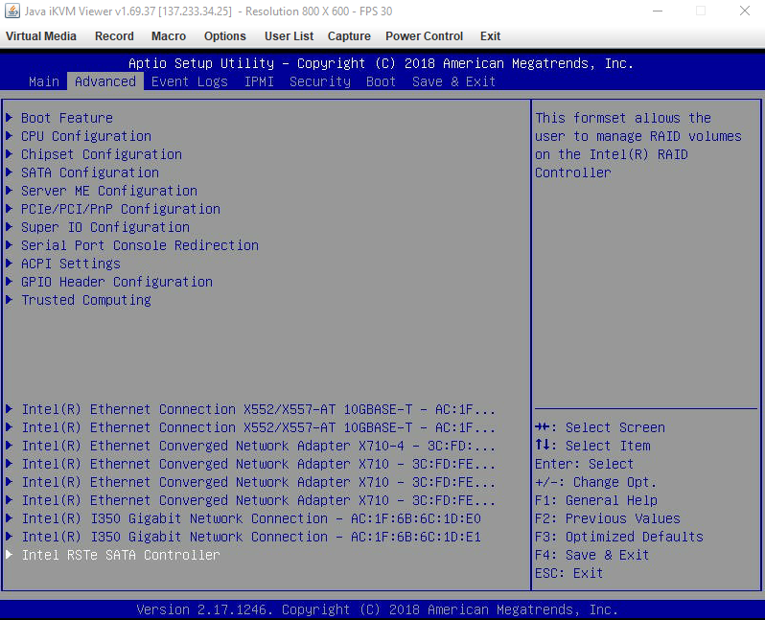
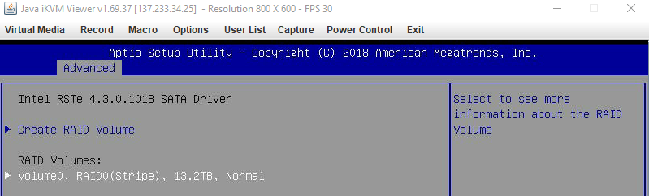
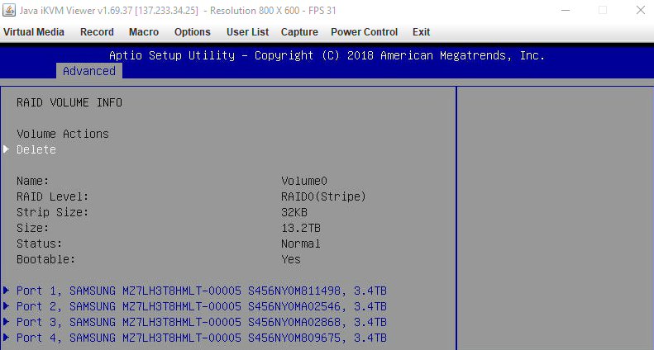
For SecurityOnion 2.3, we will have to delete the RAID configuration from the BIOS
Interrupt the boot-up and go into the BIOS Settings
From the BIOS screen, got to Advanced and select “Intel RSTe SATA Controller”
From the RAID configuration screen, select any logical volume that might exist
From the RAID Volume Information screen, select Delete and confirm the deletion when prompted

Slide 8
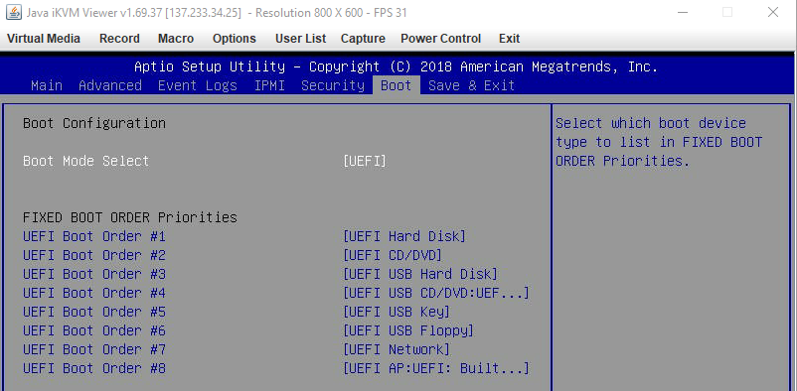
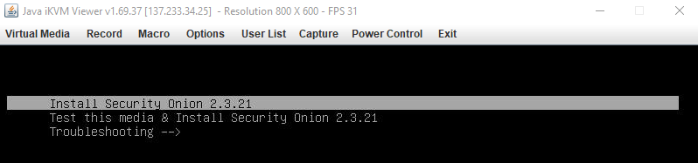
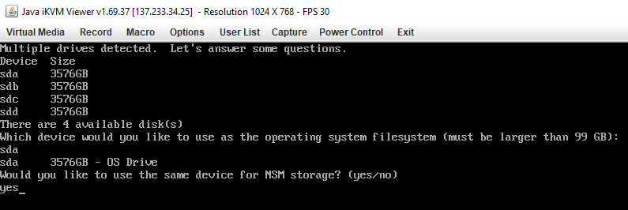
After you save the RAID configurations, the server should boot into the SecurityOnion installer wizard. If it does not, check the boot options on the sensor/server’s BIOS to ensure the virtual CD-ROM is part of the boot sequence.
When the Security Onion GRUB menu shows up, select “Install Security Onion 2.3.XX”
Once the installer fully boots up, you should be prompted to select which of the 4 hard drives to install Security Onion on. Enter “sda” and press Enter.
When you are prompted whether to install NSM on the same storage device, enter “yes”

Slide 9
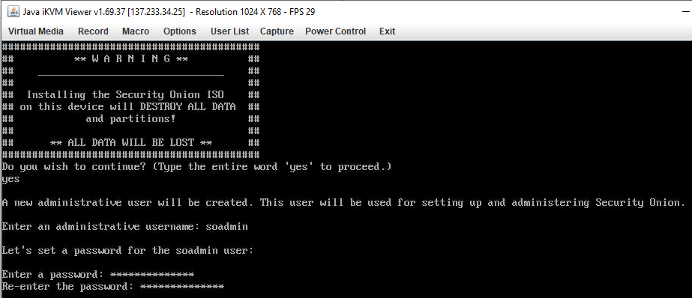

You will be prompted to confirm the install. Enter “yes”
When you are prompted for a username, use soadmin (change according to SOP)
You will be prompted for a password for the user specified.
After the OS installation is complete, you will be prompted to reboot.

Slide 10
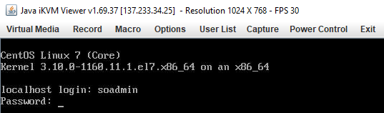
You will be prompted to confirm the install. Enter “yes”
When you are prompted for a username, use soadmin (change according to SOP)
You will be prompted for a password for the user specified.
After the OS installation is complete, you will be prompted to reboot.
Once the sensor/server reboots, login with the username created during the install process

Slide 11
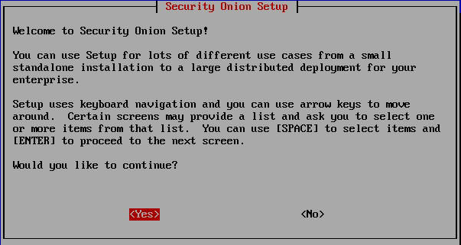
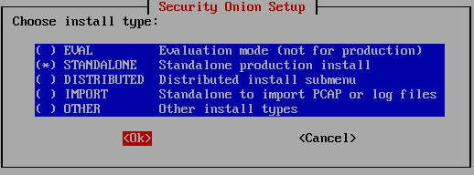
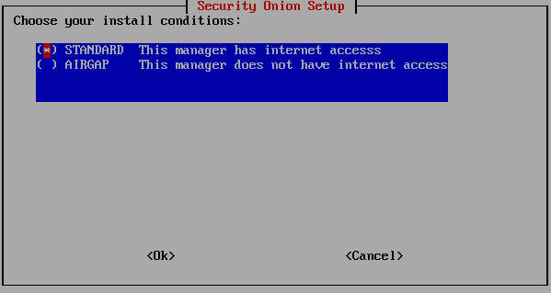
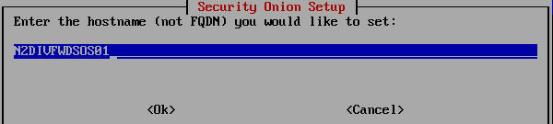
Once the Security Onion setup wizard starts, select yes to continue
Since this guide is specific to a Standalone setup, we will select STANDALONE as the install type
If the guide is being followed to setup a NIPR sensor, select STANDARD for the install condition. Otherwise, select AIRGAP for other networks (i.e SIPR, MS, etc.)
For the hostname, follow the local site’s naming standards

Slide 12
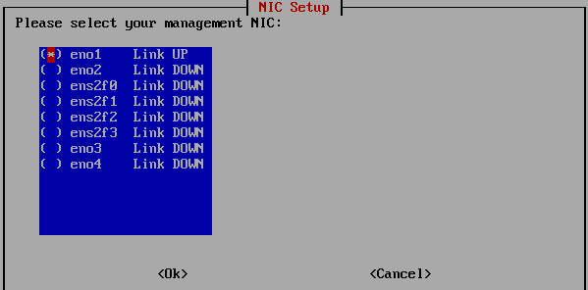
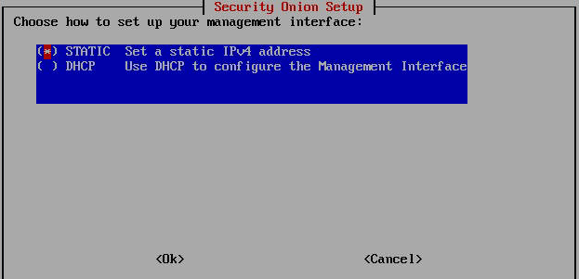
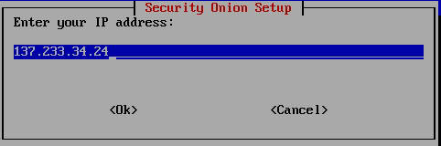
If you followed the guidance in page 2 of this document, choose eno1 as the management interface. Otherwise, choose the interface you designated as management.
For the addressing type, choose STATIC
When assigning the IP address for the sensor, assign it the IP address given to you by the local administrators. This guide assumes the IP given is on the same VLAN as the rest of the servers.

Slide 13
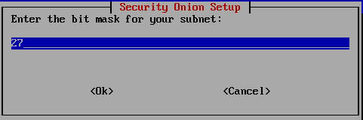
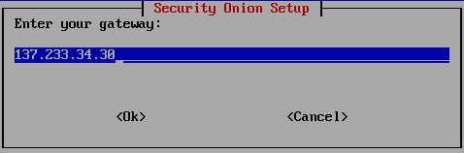
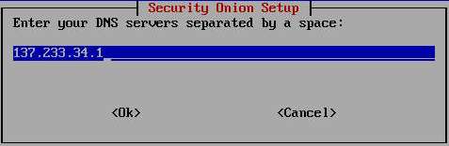
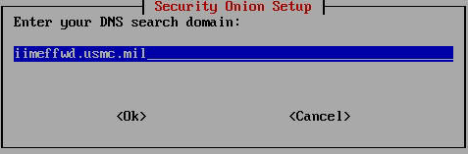
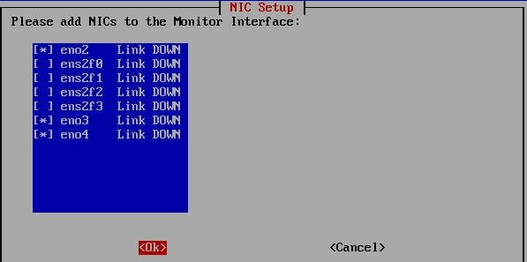
Ensure the subnet mask is correct according to the network the sensor will be in
Enter the default gateway accordingly
Enter the IP address of the local site’s DNS server
Enter the DNS search domain for the local site
In the Monitor Interface screen, select all the interfaces that will be used to receive traffic to be sniffed.

Slide 14
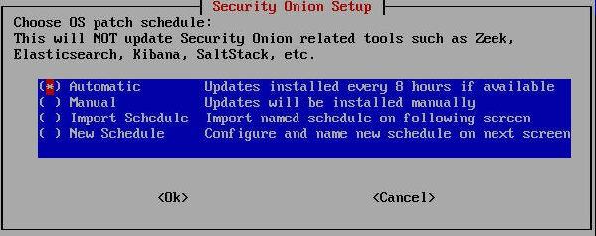
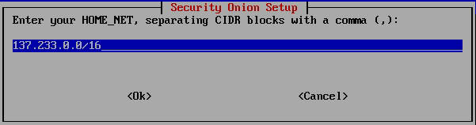
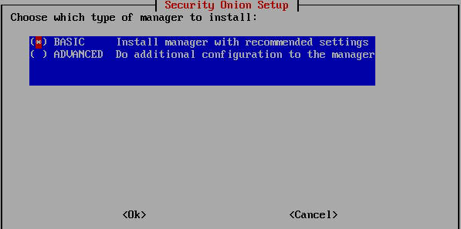
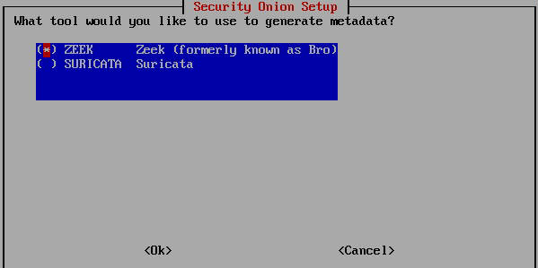
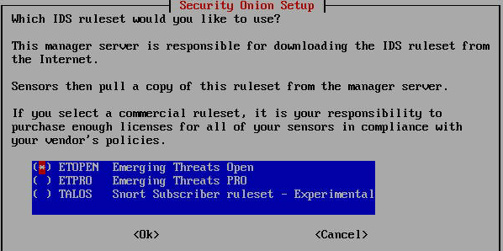

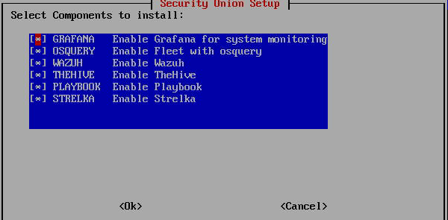

Select Automatic as the OS patch schedule
Change the HOME_NET value to the local network
Use the defaults for the next set of screens

Slide 15
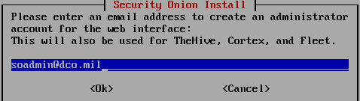
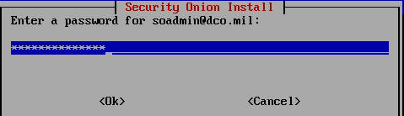
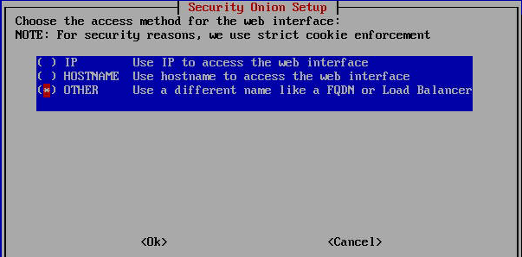
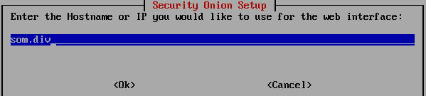
When asked for an application use, enter soadmin@dco.mil (change according to SOP)
Enter and verify the password for the application user
For the web interface access method, select the method that best suites need. You can specify an alternate access method by selecting OTHER as follows:
Note: the method shown above requires that the DNS infrastructure is setup to resolve som.div to the IP address of the sensor

Slide 16
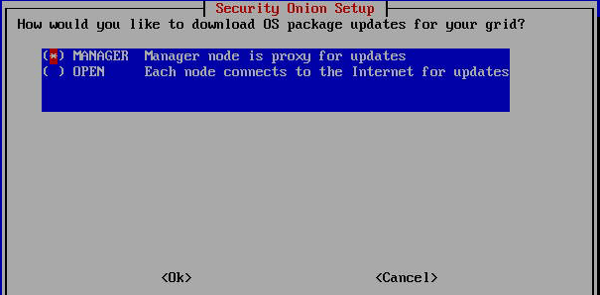
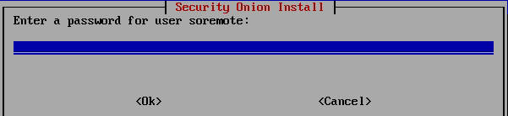

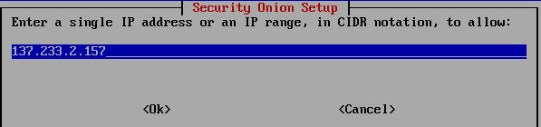
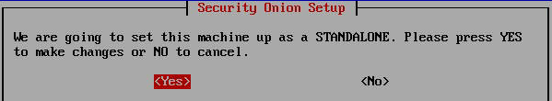
Select MANAGER for the update download method
You will be prompted to enter a password for the soremote user. Since this guide is intended for a standalone deployment, the soremote user will never be used.
Select the defaults through the next screen until you get to the prompt to run so-allow. Select Yes
Enter the initial IP address that should have access to the sensor
At the final screen, select Yes to start the setup process
When the setup is finished, you will be prompted to reboot. Reboot the sensor. If the setup did not properly, read the log in /root/setup.log to troubleshoot the issue.

Slide 17
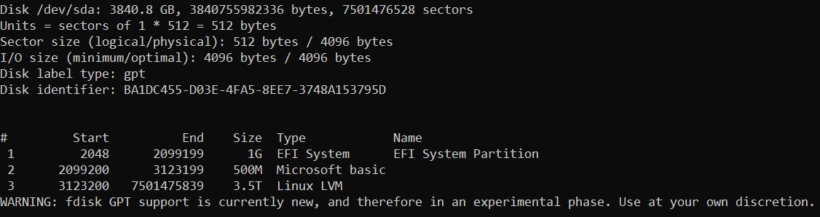
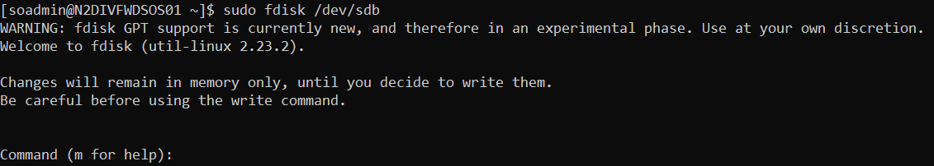
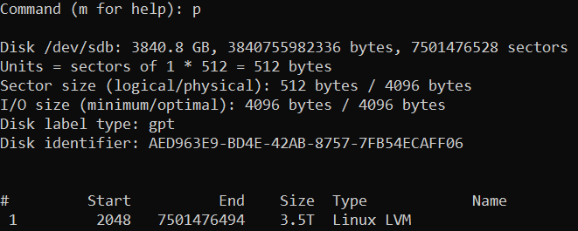
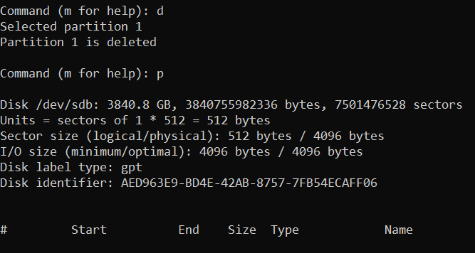
Once your sensor reboots, you will have to use lvm to combine the remaining 3 hard drives.
Run “fdisk -l” to list your hard drives. You should see sda, sdb, sdc, and sdd. The sda disk is where the OS is currently installed on and should have multiple partitions. If you see any partitions on the other three disks, we will delete them in the upcoming steps.
Run “sudo fdisk /dev/sdb”. You will be presented with the fdisk prompt. You can press the M key to see what available options you have
Press the P key to print the current partition table on sdb.
If any partitions were listed in the previous step, press the D key to delete it followed by the P key to ensure the partition table is empty.

Slide 18
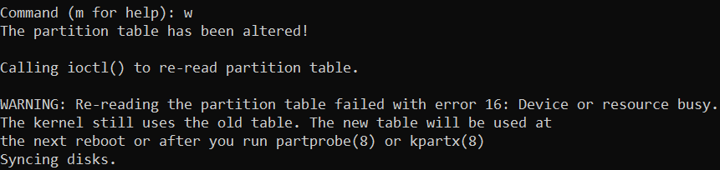
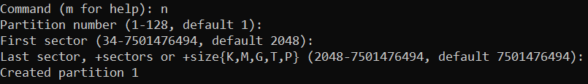



Press the W key to save the changes to the disk. You will get an error saying that the resource is in use.
The previous step will give you an error. Perform the same actions on /dev/sdc and /dev/sdd. Once done, reboot the sensor to ensure the changes take effect.
Once your sensor has been rebooted. Run “sudo fdisk /dev/sdb”
Press the N key to create a new partition (partition 1). Use the default values (press enter through the prompts) that are auto-populated.
Press the T key to change the partition’s system ID followed by the L key to list all possible IDs. You will be presented with a large list. Identify the two-digit number associated with “Linux LVM.”
Enter the two-digit number (yours might not be 31).
Press the W key to save the partition changes.
Perform the same steps to create the partition for sdc and sdd.

Slide 19




Run “sudo pvdisplay” to list the physical volumes
If any partitions from /dev/sdb, /dev/sdc, or /dev/sdd show a value for VG Name, run “sudo vgremove <VG Name>” (Ex: sudo vgremove nsm)
Run “sudo pvcreate /dev/sdb1 /dev/sdc1 /dev/sdd1” to prepare the volumes
Run “sudo vgcreate nsm /dev/sdb1 /dev/sdc1 /dev/sdd1” to create a volume group named nsm
Run “sudo vgdisplay” to list the volume groups (optional)
Run “sudo lvcreate --name nsm --size 10.4T nsm” to create a logical volume named nsm in the nsm volume group. If you get prompted to wipe an existing signature, press y to purge it.

Slide 20




Run “sudo lvdisplay” to list the logical volumes. You should now see /dev/nsm/nsm
Run “sudo lvscan”
Run “sudo mkfs.xfs -f /dev/nsm/nsm” to format the new logical volume as xfs
Elevate your shell to root by running “sudo su”
Run “docker stop $(docker ps -aq)”. This will stop all docker containers that are currently running.

Slide 21

Run “mount /dev/nsm/nsm /mnt” to mount the nsm volume in the /mnt directory
Run “cp -av /nsm/* /mnt” to copy all files from the /nsm directory (currently located in a system LV) to the /mnt directory (currently located in the nsm LV)
Edit the /etc/fstab file and change the “/dev/mapper/system-nsm” path to “/dev/nsm/nsm”
Reboot the sensor
Wait for the sensor to power back on and all SO services to start. If there are any errors, have fun googling, or running on only one 3.4T hard drive, or using a hypervisor to make a virtual sensor while dealing with the headache of making promiscuous vswitches, or quitting to start our new jobs at Walmart.

Slide 22

Troubleshooting
If you run into errors during the OS installation process, it is most likely due to old files on the hard drives.
If you run into issues when using fdisk for any one of the disks, other than the errors already documented in the steps, you will have to clean the disk with another utility (gparted, diskpart, etc

